Slide 1
1) Remove the A42 related data on slide 2 and regenerate the graph and model
2) Pairwise comparison model 1 (data from slide 2):
A118: Setting LB as baseline and comparing PF, ignore PBS altogether
AB5075: Setting LB as baseline and comparing PF, ignore PBS altogether
3) Pairwise comparison model 2 (data from slide 4):
A118: Setting LB as baseline and comparing CSF, ignore PBS altogether
AB5075: Setting LB as baseline and comparing CSF, ignore PBS altogether
We want to see if mortality differences are significant when comparing PF and CSF to LB essentially

Slide 2
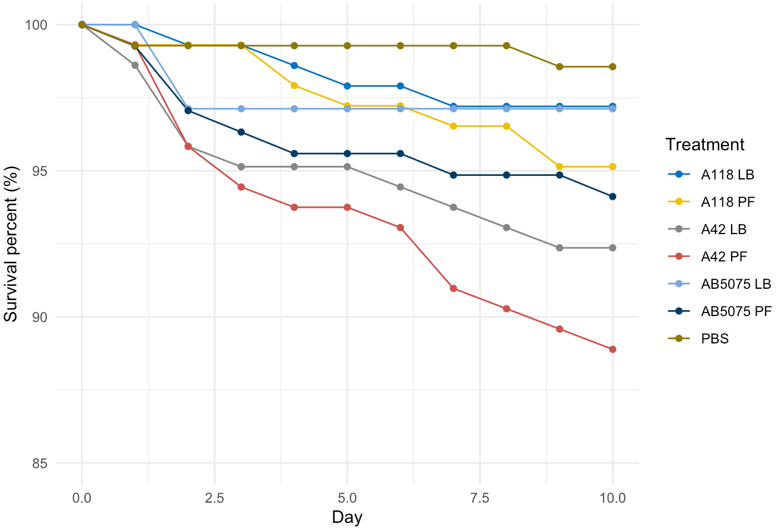
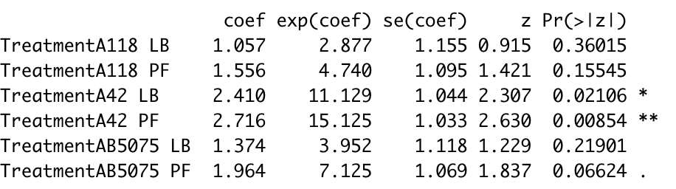
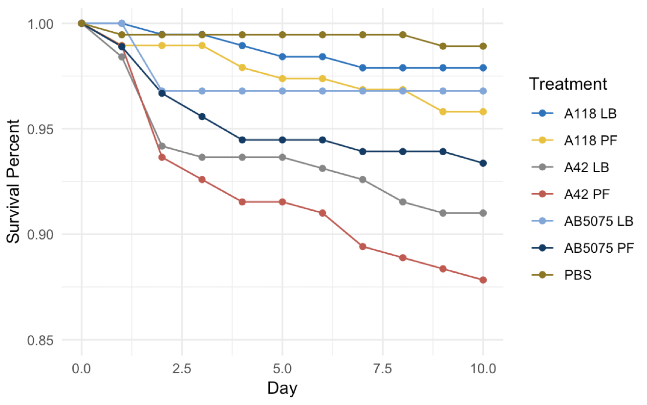
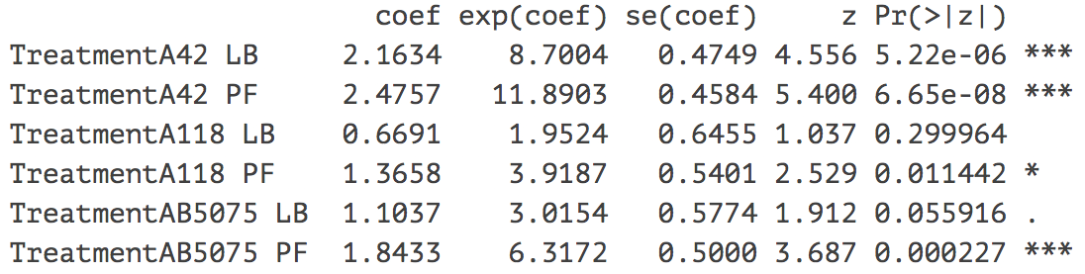
PF Paper Data
New Cox Model Results 4-22-2020
Old Cox Model Results 5-13-2019
Hazard ratios
Summary:
A42 LB: <0.001 → 0.02
A42 PF: <0.001 → 0.008
A118 LB: 0.29 → 0.36
A118 PF: 0.01 → 0.15*
AB5075 LB: 0.055 → 0.219*
AB5075 PF: <0.001 → 0.066*

Slide 3
To test the influence of PF in A. baumanii pathogenesis, a Drosophila melanogaster infection model was used. Inoculation with A118 or AB5075 grown in LB did not affect survival of flies relative to controls (p=0.36, p=0.219). A118 and AB5075 cultured in PF showed decreased survivorship relative to controls (p=0.155, p=0.06). It is noteworthy that the D. melanogaster population used in this study is outbred and has been shown to be more robust than inbred fly lines used in many laboratories (Reference number). Thus, even in highly robust D. melanogaster populations, there is an observable increase in virulence of A. baumannii when exposed to CSF. These results showed that the presence of CSF increases the virulence of A. baumannii. Furthermore, this is, to our best knowledge, the first utilization of D. melanogaster as model of infection of A. baumannii. We are presently performing comparative infection assays using other well-established models to further validate D. melanogaster as a viable and convenient model.

Slide 4
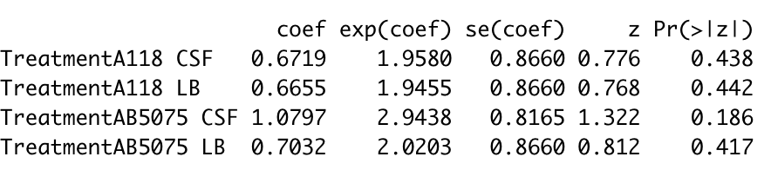
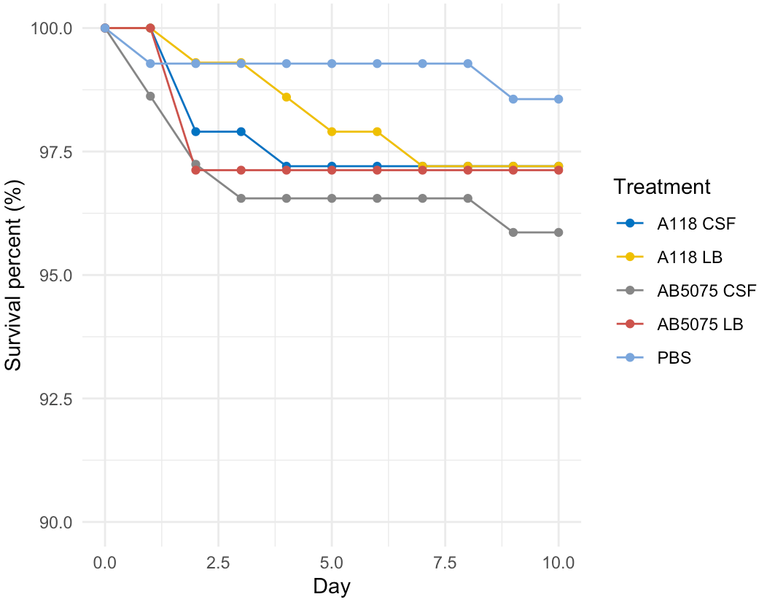
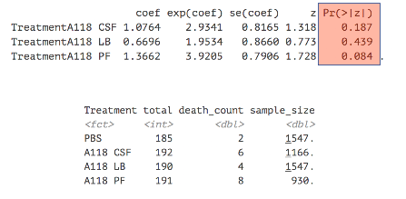
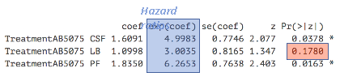
New Cox Model Results 4-22-2020
Bacteria: A118, AB5075 combined
Conditions: PBS (baseline), LB, CSF
Old Cox Model Results
Summary:
A118 CSF: 0.187 → 0.438
A118 LB: 0.439 → 0.442
AB5075 CSF: 0.0378 → 0.186
AB5075 LB: 0.178 → 0.417

Slide 5
To test the influence of CSF in A. baumanii pathogenesis, a Drosophila melanogaster infection model was used. Inoculation with A118 or AB5075 grown in LB did not affect survival of flies relative to controls (p=0.442, p=0.417). A118 growth in CSF did not affect survival relative to controls (p=0.438). However, for Ab5075 when the bacterial cells were cultured in the presence of CSF, the survival was reduced to 94% of inoculated individuals for (Figure 2C, P-value=0.186). It is noteworthy that the D. melanogaster population used in this study is outbred and has been shown to be more robust than inbred fly lines used in many laboratories (Reference number). Thus, even in highly robust D. melanogaster populations, there is an observable increase in virulence of A. baumannii when exposed to CSF. These results showed that the presence of CSF increases the virulence of A. baumannii. Furthermore, this is, to our best knowledge, the first utilization of D. melanogaster as model of infection of A. baumannii. We are presently performing comparative infection assays using other well-established models to further validate D. melanogaster as a viable and convenient model.

